Slide 1
Comparing six fluorometers to extracted methods of quantifying chlorophyll and phycocyanin

Slide 2
Goals
Compare six different fluorometers across a range of prices and assess their precision and accuracy compared to extracted chlorophyll and phycocyanin
Develop a deeper understanding of the strengths of the different fluorometers
Notes:
We wanted to…

Slide 3
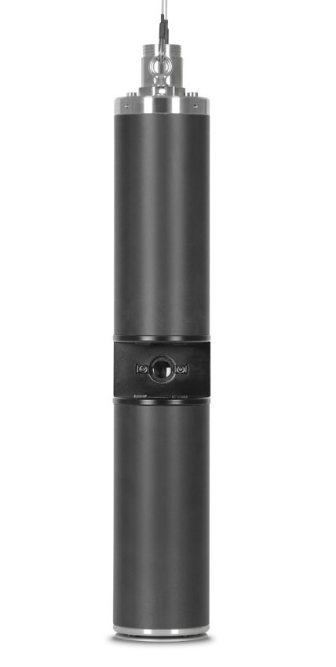
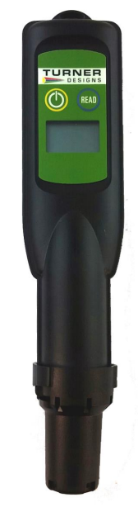
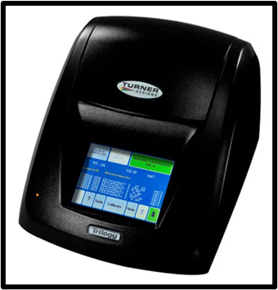
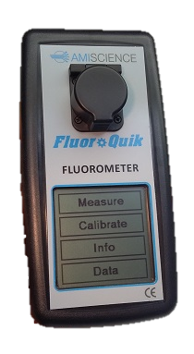
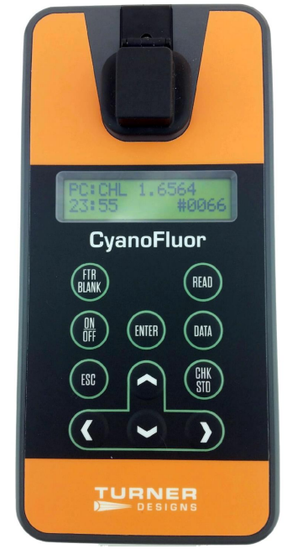
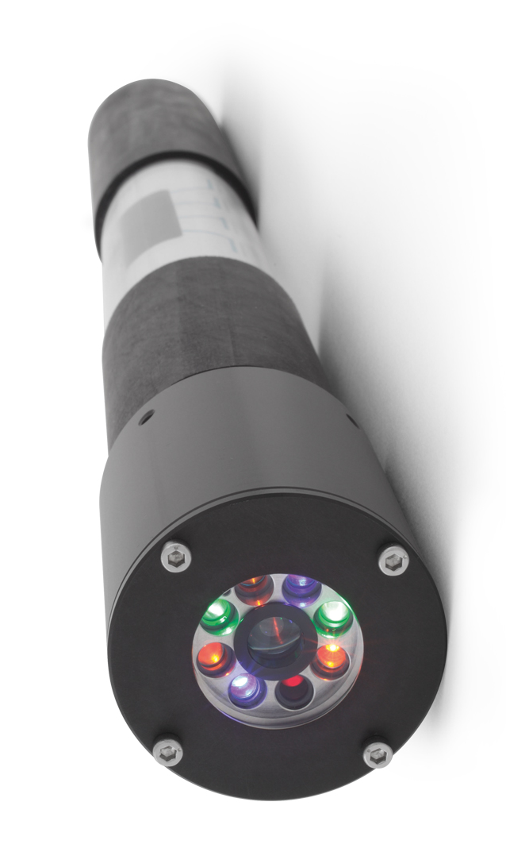
The Fluorometers
bbe
PhycoProbe
Turner Trilogy
3 Modules:
Chlorophyll a Extracted –
Non-Acidification
Phycocyanin Extracted
Chlorophyll in vivo
Turner
FluoroSense
Turner CyanoFluor
AmiScience
FluoroQuik
bbe
AlgaeTorch
Notes:
Here is an overview

Slide 4
The Fluorometers
Company | Instrument | In vivo vs In situ | Variables | Units | Range | Manufacturer MDL
Turner | Trilogy - Phycocyanin Extracted | In situ | phyco | RFU, µg/L | PC: 0-10,000 µg/L | PC: 2 µg/L
Turner | Trilogy - Chlorophyll a Extracted (Non-Acidification) | In situ | chl-a | RFU, µg/L | CHL: 0-300 µg/L | CHL: 0.025 µg/L
Turner | Trilogy - Chlorophyll In-vivo | In situ | chl-a | RFU | CHL: 0-300 µg/L | CHL: 0.025 µg/L
Turner | CyanoFluor | In situ | chl-a, phyco, PC:CHL ratio | RFU | PC/CHL: 0-100 µg/L | PC/CHL: 0.3 µg/L
Turner | FluoroSense | In vivo | phyco | µg/L | PC: 0-199 µg/L | not listed - semi-qualitative
bbe | AlgaeTorch | In vivo | chl-a, cyanobacteria (using chl-a as proxy) | µg/l | CHL: 0 - 200 µg/l | CHL: 0.15 µg/l
bbe | PhycoProbe | In vivo/In situ | green algae, blue-green algae, diatoms, cryptophyceae, total chl-a (all using chl-a as proxy), & unbound phycocyanin (μg /l) | µg/L | CHL: 0 - 200 µg/l
AmiScience | FluoroQuik | In situ | chl-a, phyco, PC:CHL ratio | µg/L, RFU | PC: 0-20,000 µg/L CHL: 0-1,000 µg/L | PC: 1.0 µg/L CHL: 0.2 µg/L
Notes:
Box = fluorometers used for the gold standard
2 field instruments
Phycoprobe: lab or field (we used in lab)
AT & Phycoprobe measure chl-a in cyanobacteria as a proxy for phycocyanin measurements
Fluorosense can be purchased for either chl or phyco (we had the phyco one)

Slide 5
Methods
Solvent-based extracted methods run on the Trilogy for chlorophyll and phycocyanin served as the gold standard
Collected 3 field duplicates for lab instruments & took triplicate measurements with field instruments at nine ponds
Avoided sediment
Cleared surface scum before sampling to avoid differences between duplicates
Notes:
Just to reiterate

Slide 6
Methods cont.
Filtered samples for the extracted chlorophyll and phycocyanin methods
Ran each field dup in triplicate on the lab instruments within 24hrs
All lab fluorometry was done in low light conditions
Re-ran samples on all lab instruments after one freeze/thaw cycle
Froze samples for at least 4hrs
Thawed in water bath until samples were between 20-24°C

Slide 7
Details
Checked calibration drift before each use (where possible)
Used recommended type of blank for all fluorometers
PhycoProbe: yellow substances calibration & blank once per pond
Notes:
Only AT didn’t have drift tracking
**Extraction: Clean filter blanks
**Phycoprobe, cyanofluor & trilogy in vivo: filtered sample water
**fluoroquik: cuvette blank

Slide 8
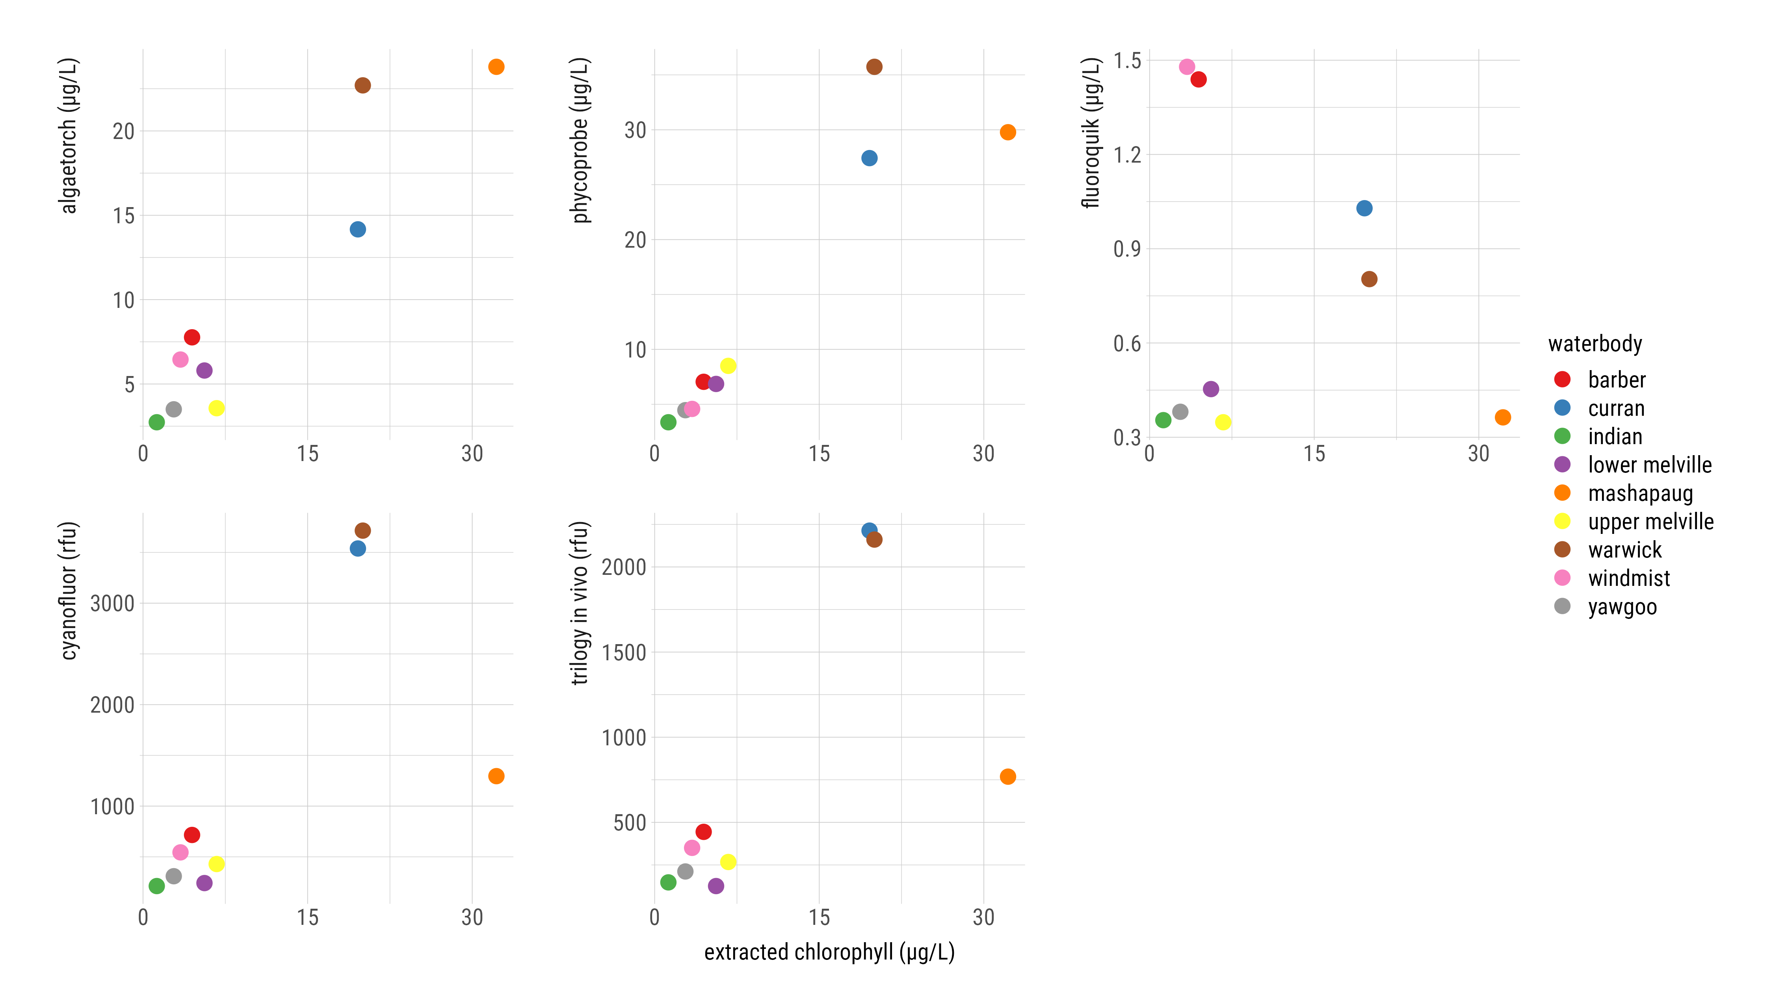
Chl a Instrument Comparison (Fresh)
Notes:
These graphs compare each instrument’s performance in measuring Chl a
comparison of instruments used according to manufacturers’ instructions & intended use
Top is ug/l, bottom is rfu
scales are different (fluoroquik very low)
War/Curran disproportionately high on cyanofluor & trilogy in vivo – reason unknown – but AT & phycoprobe handled them better
The fluoroquik doesn’t show a linear relationship to the extracted chlorophyll like we would expect to see, while the other instruments are more consistent with the extracted method

Slide 9
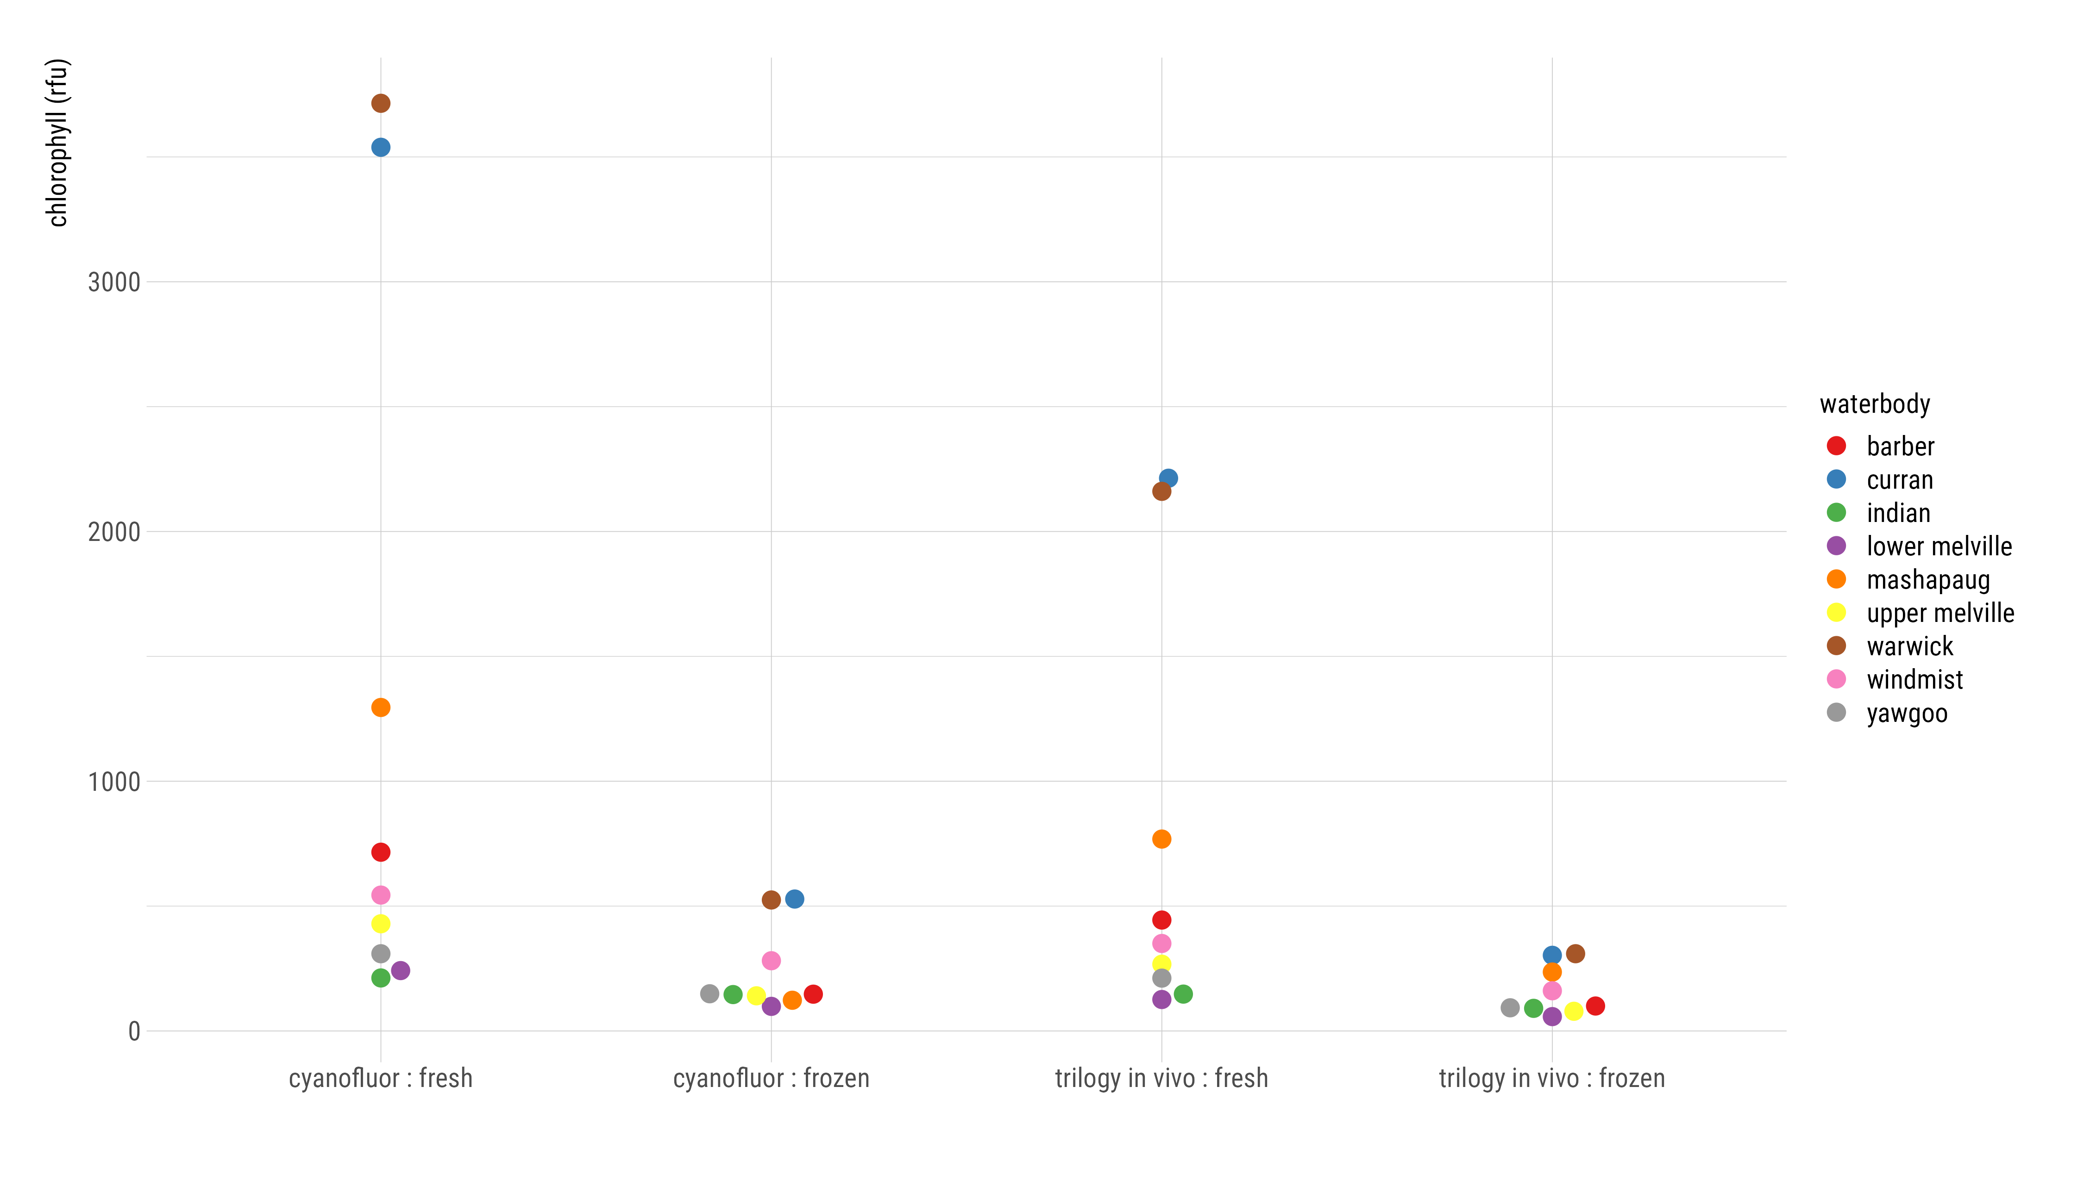
Chl a Fresh vs Frozen (RFU)
Notes:
Compares fresh and frozen values on instruments that read in RFUs
Can’t compare RFUs across instruments
Cyanofluor & trilogy readings are lower after a freeze/thaw cycle
The order of the waterbodies from low to high also changes
On the cyanofluor, Mashapaug goes from having more chl a than windmist in the fresh data to less than windmist after being frozen
**According to extracted methods, curran & mash values should be similar/slightly lower than Mashapaug but they remained higher after freezing

Slide 10
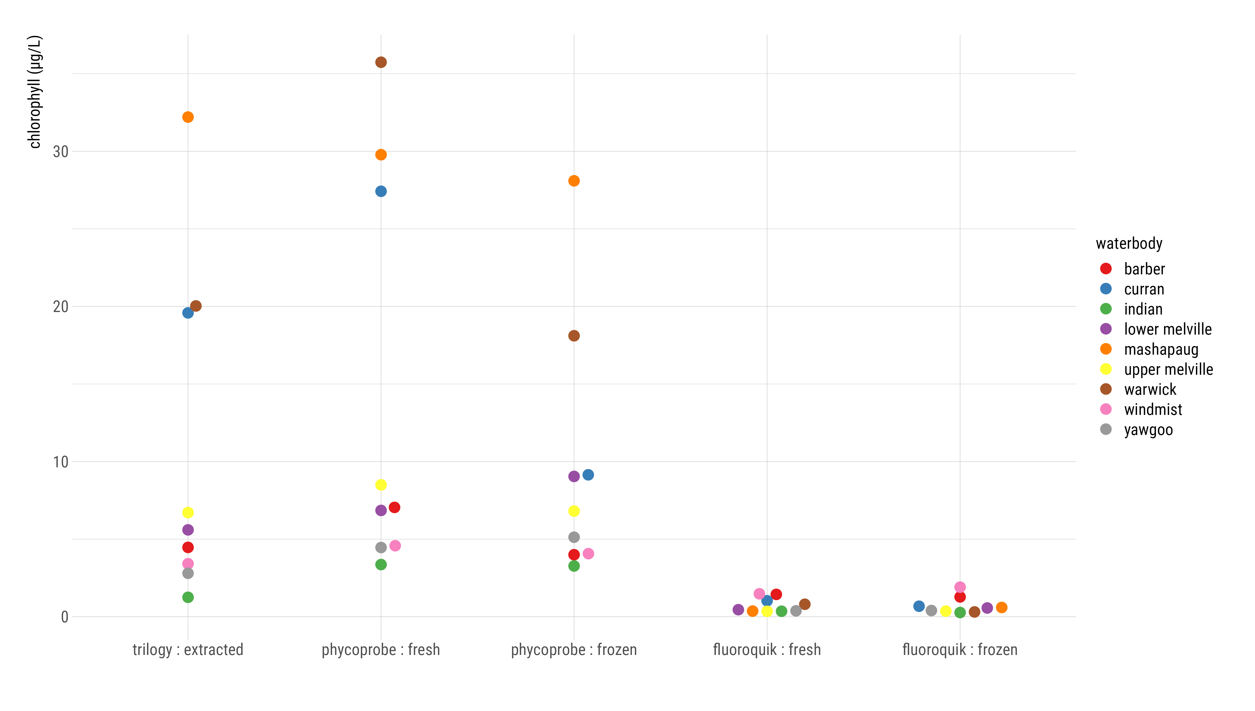
Chl a Fresh vs Frozen (µg/L)
Notes:
Fluoroquik shows very similar values between fresh and frozen samples
Phycoprobe: curran value decreased significantly after freezing
However, freezing had the least effect on the phycoprobe values
Potential to be able to use the phycoprobe in this way

Slide 11
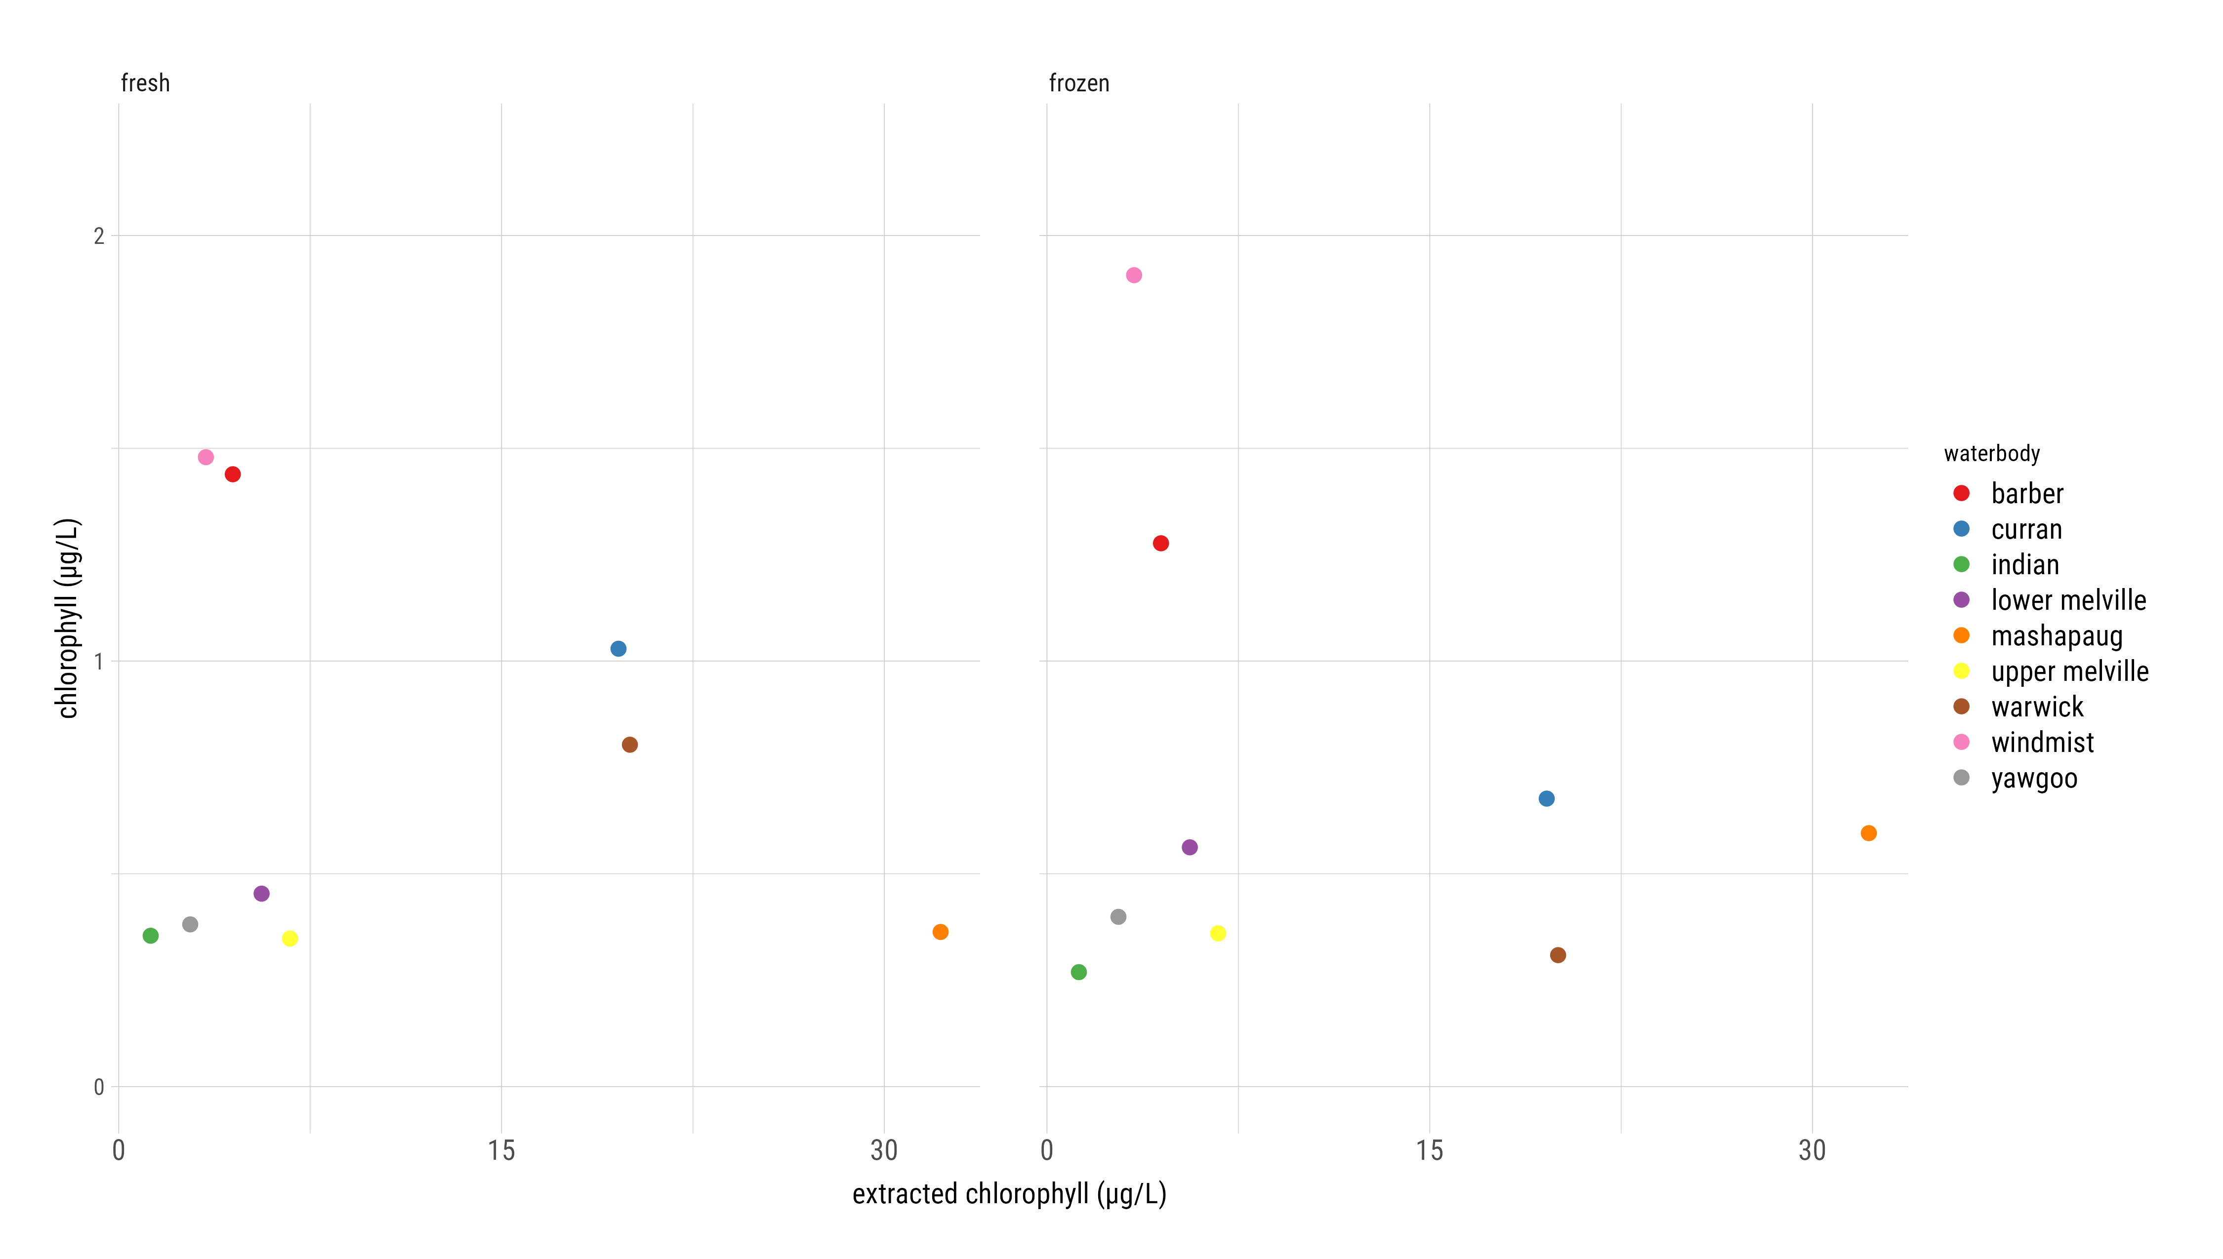
FluoroQuik Chl-a Fresh vs Frozen
Notes:
Included bc freezing is official method
Two plots look very similar
Most values decrease slightly
Freezing doesn’t have a big impact on chl a
Not a linear relationship to extracted

Slide 12
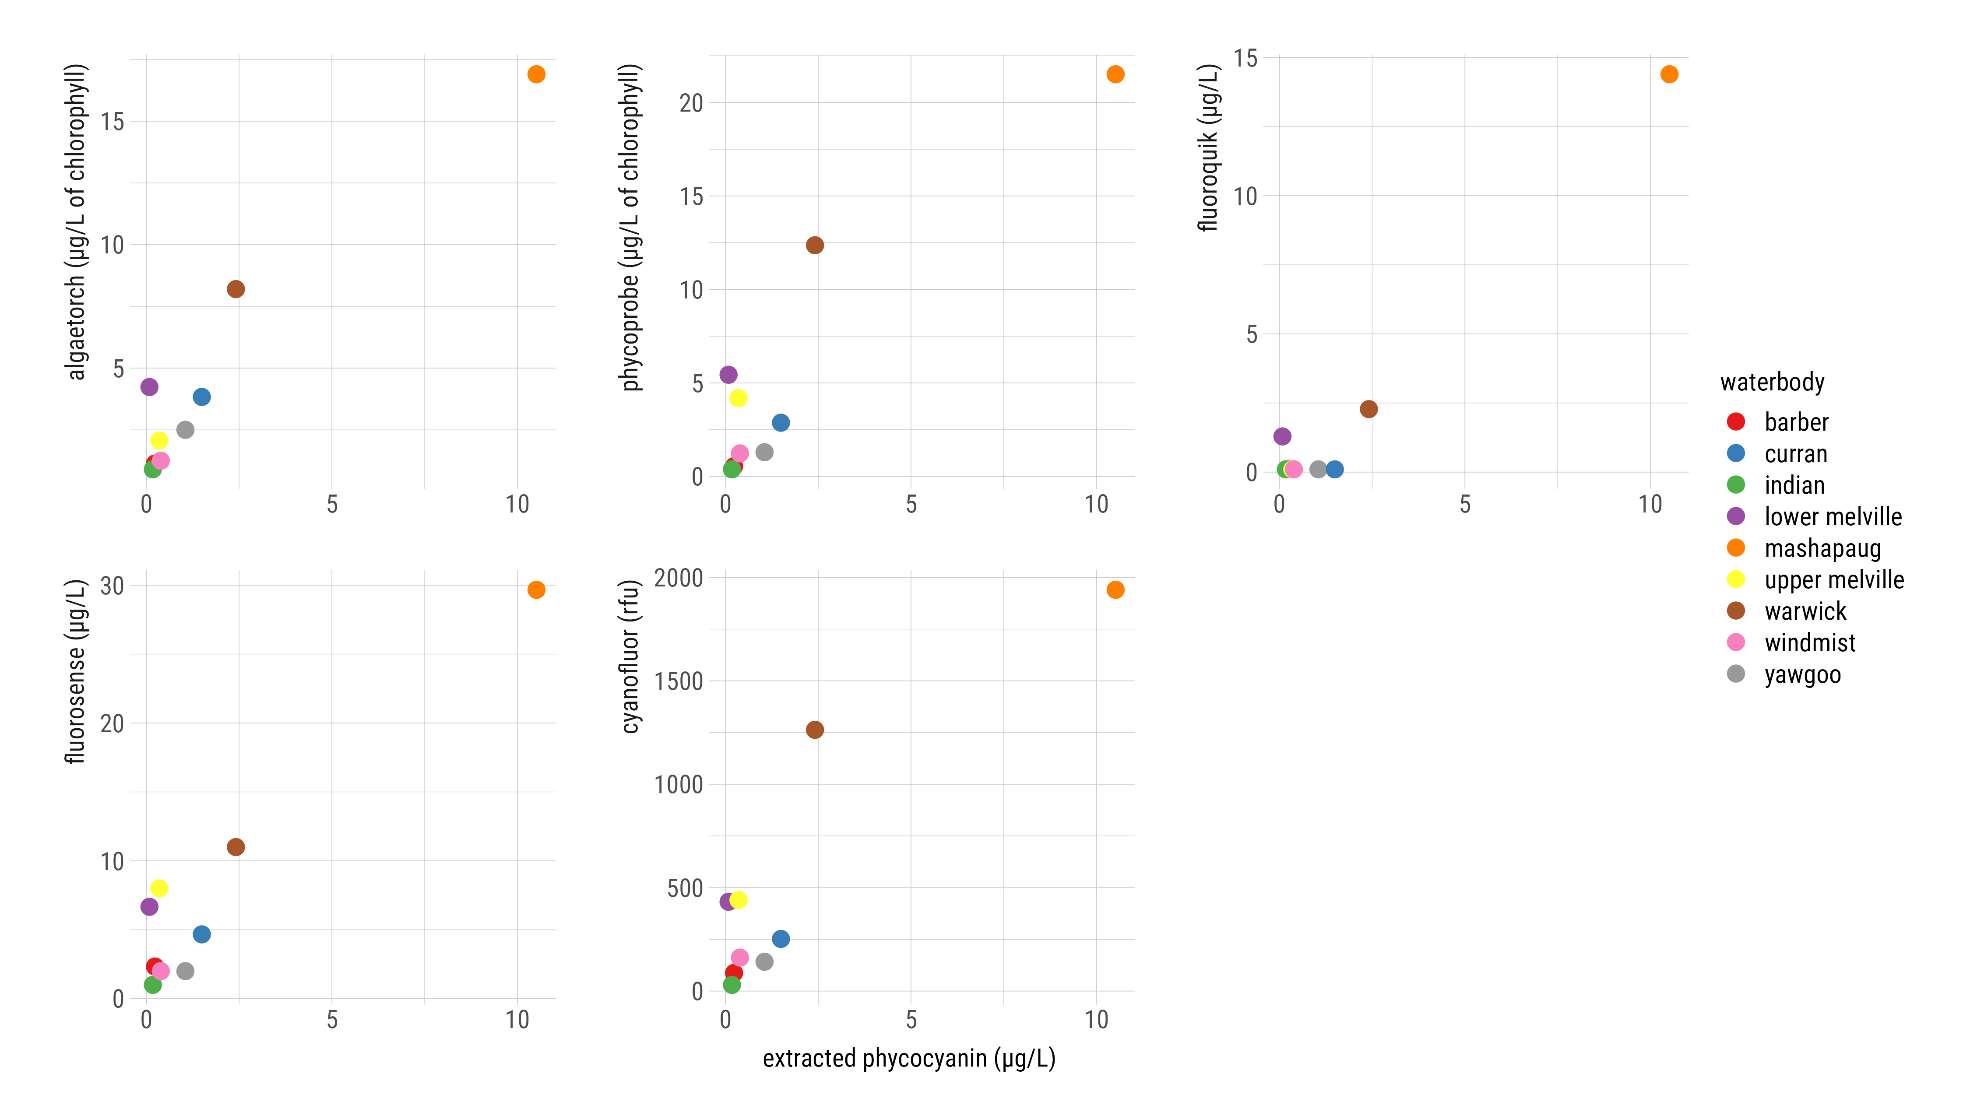
Phycocyanin Instrument Comparison (Fresh)
Notes:
Comparison of instruments used according to manufacturers’ instructions & intended use
All in ug/l except cyanofluor
AT and Phycoprobe measure ug/L of chlorophyll from cyanobacteria
Scales are different - Fluorosense scale is high
Fluoroquik has a lot of non detects
All instruments do pretty well with phyco in comparison to extracted
**If someone asks: It’s possible that our phycocyanin extraction method doesn’t extract as much phycocyanin as it could and so the results are lower than they should be

Slide 13
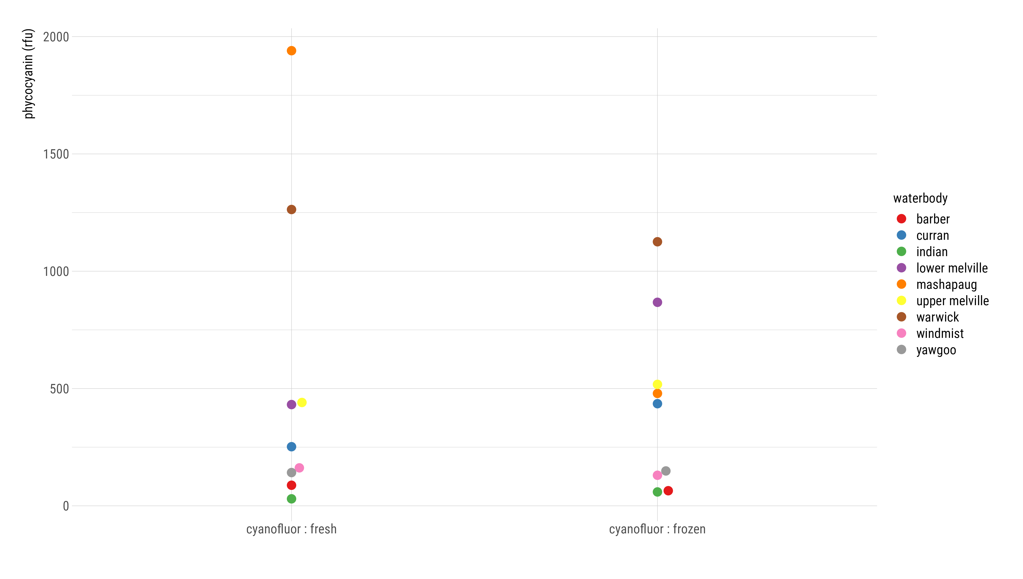
Phyco Fresh vs Frozen (RFU)
Notes:
The order of the waterbodies changes after freezing – Mashapaug should still be highest
Some get lower, others get higher
Overall cyanofluor shows inconsistent results after a freeze/thaw cycle

Slide 14
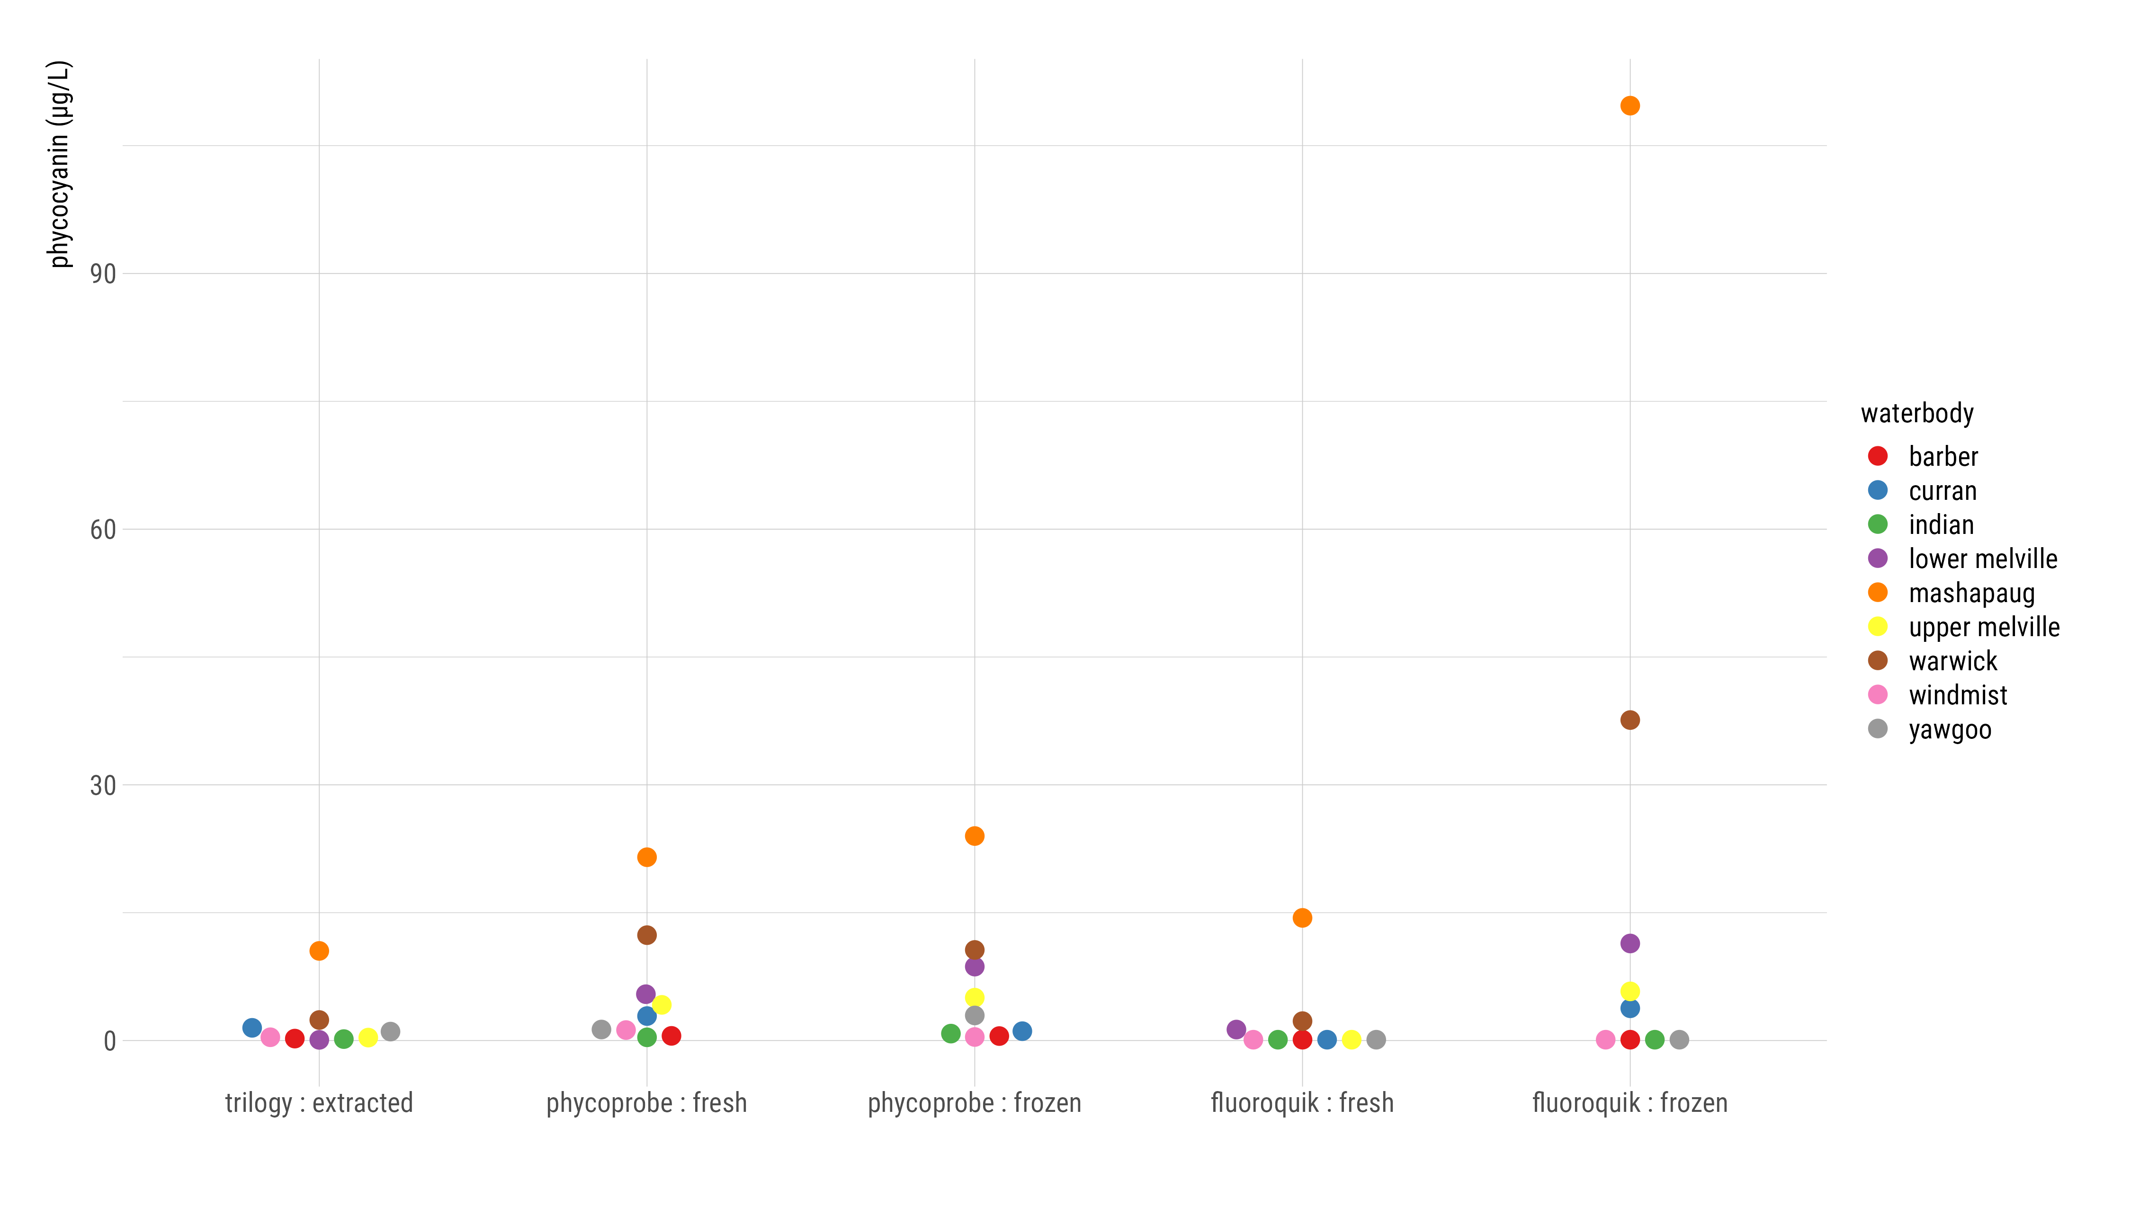
Phyco Fresh vs Frozen (µg/L)
Notes:
Again phycoprobe doesn’t show much difference between fresh and frozen values
Fluoroquik results increase after freezing for phyco

Slide 15
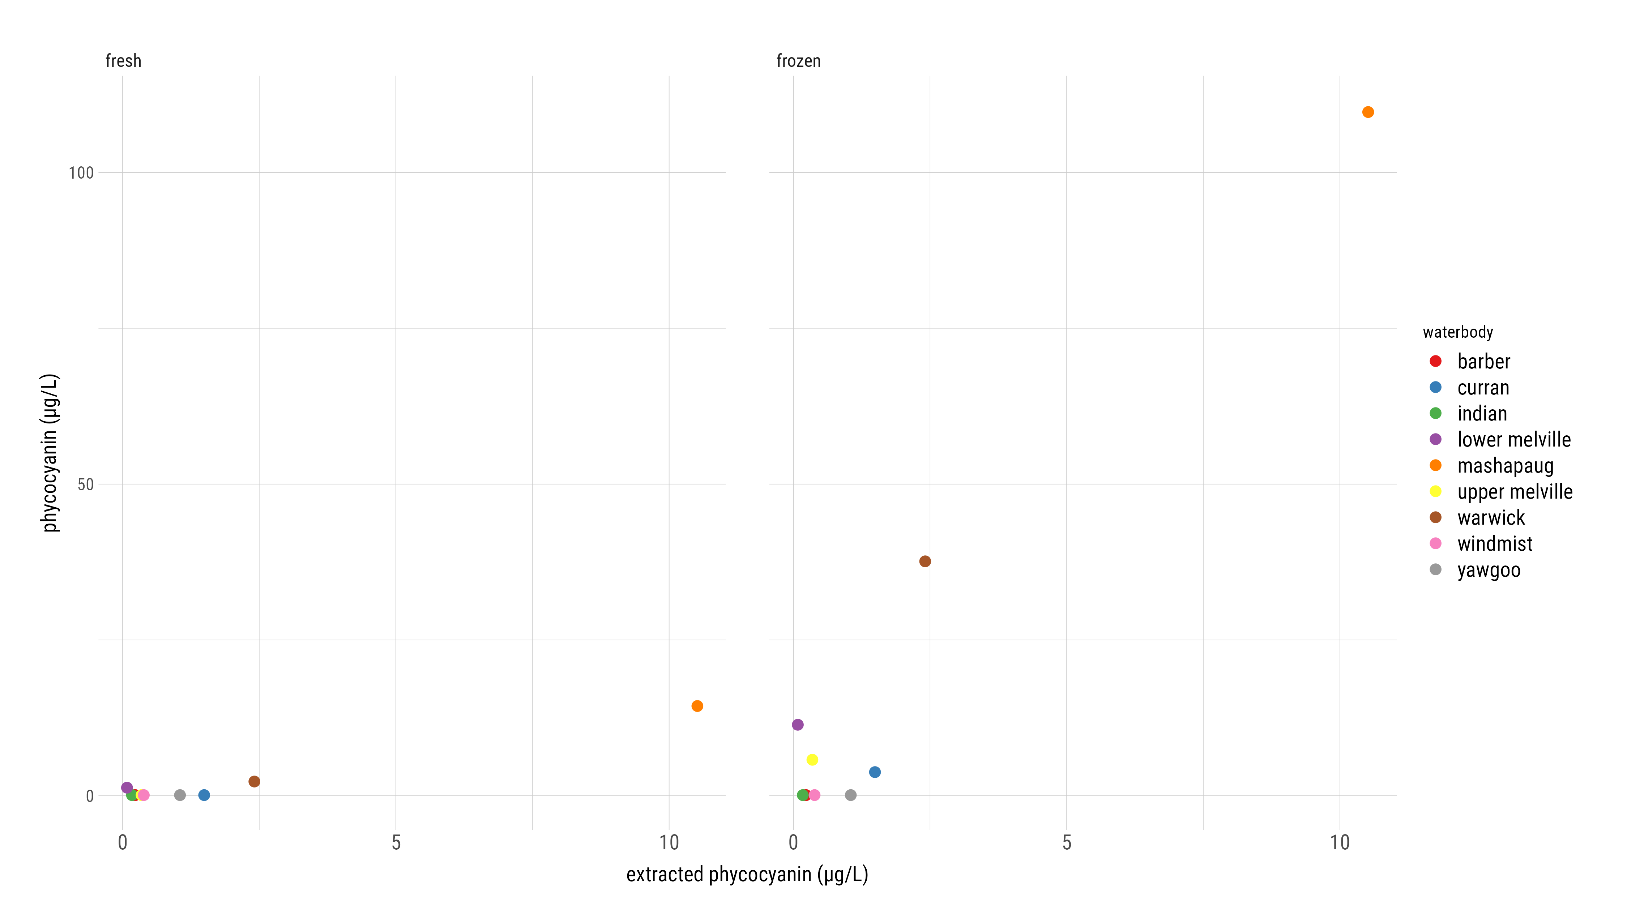
FluoroQuik Phyco Fresh vs Frozen
Notes:
Values increase slightly on the low end and around ten-fold on the high end

Slide 16
Conclusions
Freezing samples before analysis on the PhycoProbe could be a viable method and provide more leniency in the time between sampling and analysis
The FluoroQuik does not measure chlorophyll accurately and it serves better in a presence/absence capacity for phycocyanin
The FluoroSense showed the strongest linear relationship to the phycocyanin extracted method
It could be a good affordable option for field detection
Notes:
Questions?

